Slide 1
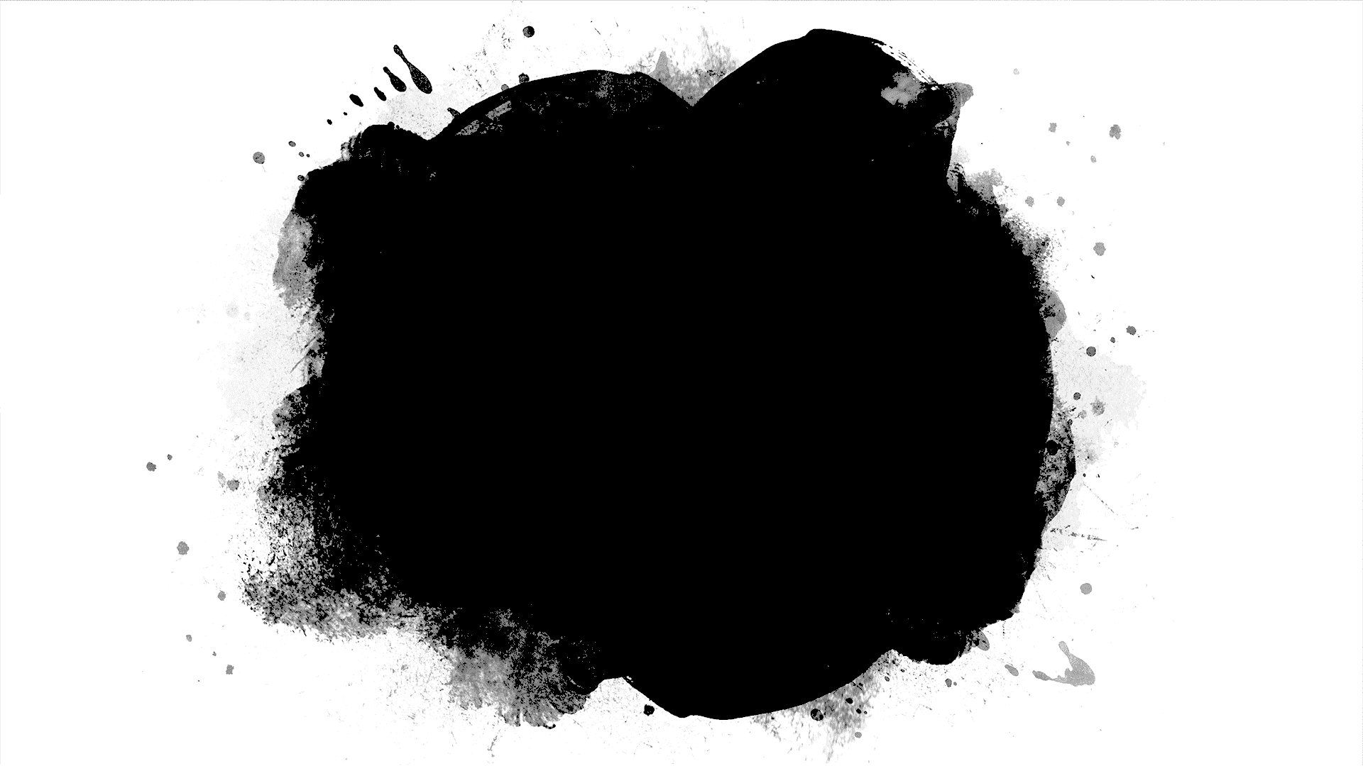
Autoencoders
Part 8

Slide 2
Autoencoder Structure
Hidden (code)
Input
Reconstruction
From Goodfellow 2016

Slide 3
Stochastic Autoencoder
Hidden (code)
Input
Reconstruction
From Goodfellow 2016

Slide 4
Constraints to avoid identity
Undercomplete autoencoders
dim(h)<dim(x)
Discard some information (or extract a code)
Overcomplete autoencoders
dim(h)>dim(x)
Regularization is necessary

Slide 5
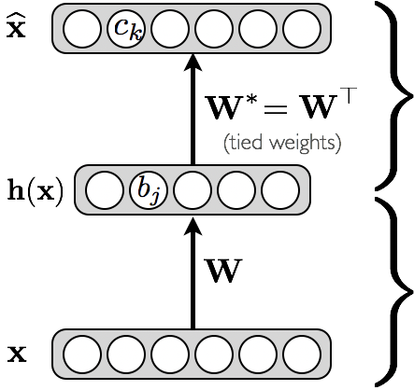
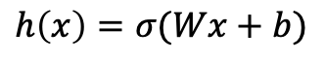
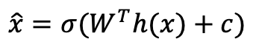
Formulation
Decoder
$$\hat{x}=σ(W^{T}h(x)+c)$$
Encoder
$$h\left(x\right)=σ(Wx+b)$$

Slide 6
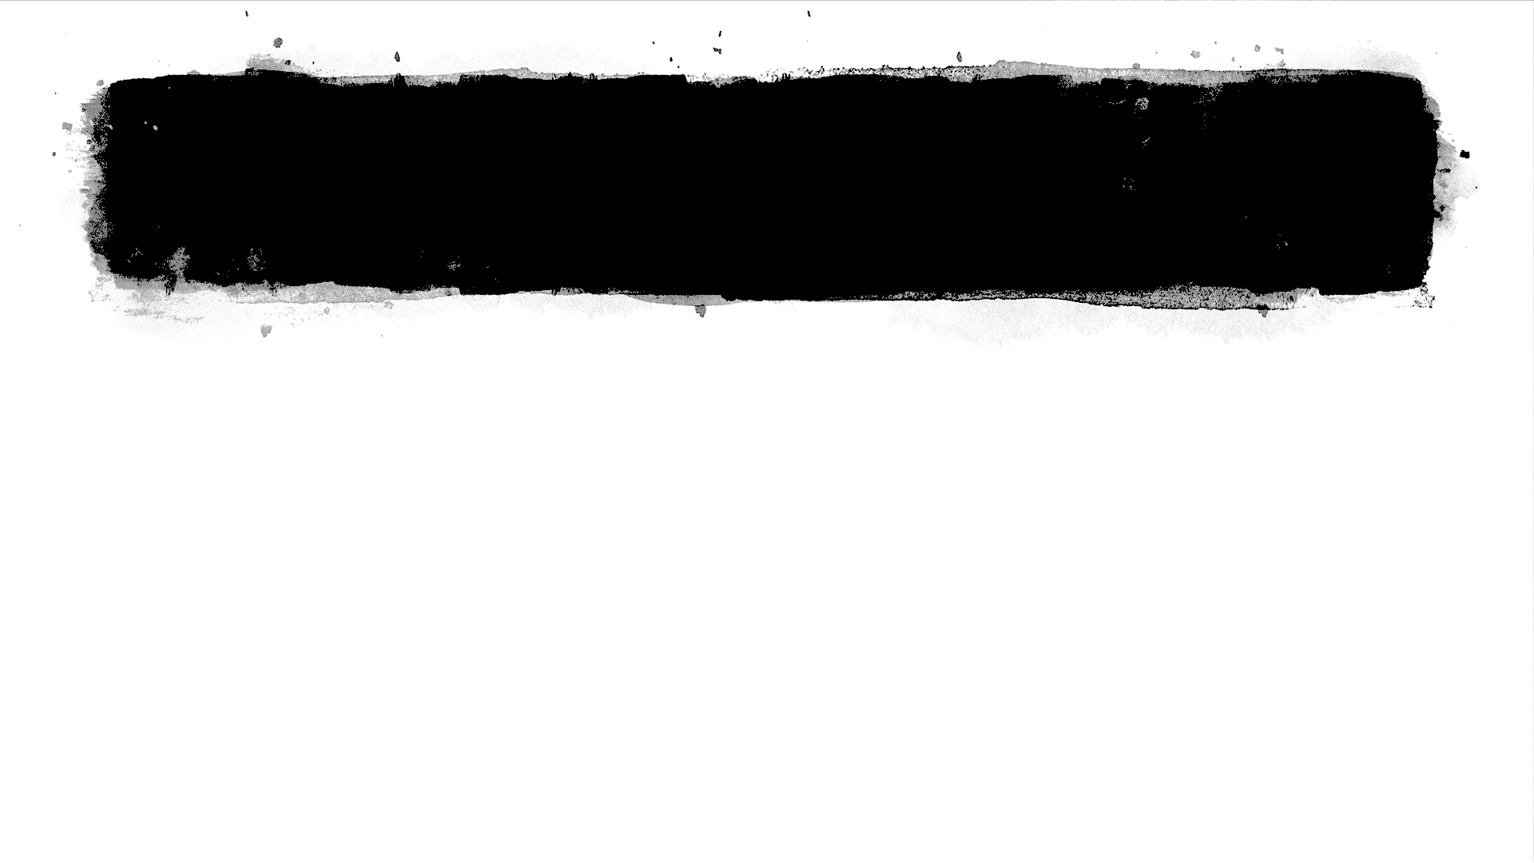
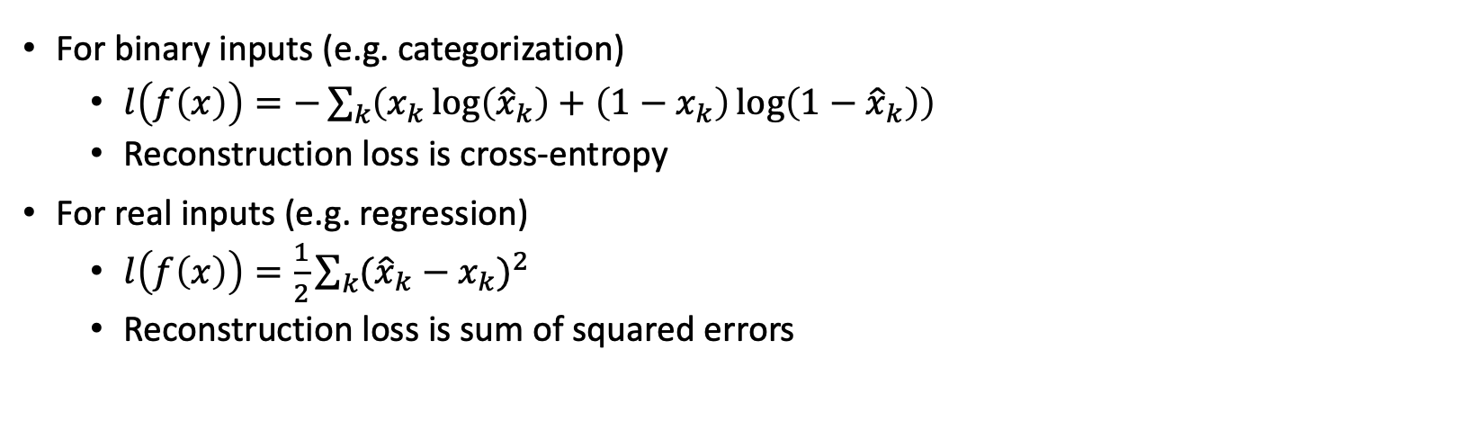
Loss functions
For binary inputs (e.g. categorization)
$l\left(f\left(x\right)\right)=−\sum_{k}{\left(x_{k}\log\left({\hat{x}}_{k}\right)+\left(1−x_{k}\right)\log\left(1−{\hat{x}}_{k}\right)\right)}$
Reconstruction loss is cross-entropy
For real inputs (e.g. regression)
$l\left(f\left(x\right)\right)=\frac{1}{2}\sum_{k}{{({\hat{x}}_{k}−x_{k})}^{2}}$
Reconstruction loss is sum of squared errors

Slide 7
PCA with undercomplete autoencoders
If h is linear, the autoencoder performs PCA
The hidden layer learns the first K principal components of the data via minimization of SSE.
If h is not linear, it generalizes PCA to a non-linear case

Slide 8
Denoising Autoencoder
Reconstruction should be robust
Gaussian noise is introduced
Similar to dropout on input, set some values to 0
Reconstruct from corrupted input
Compute loss from clean input
C introduces noise
From Goodfellow 2016

Slide 9
Manifold Learning
Manifold: a topological space that is locally Euclidean
http://mathworld.wolfram.com/Manifold.html
From Goodfellow 2016

Slide 10
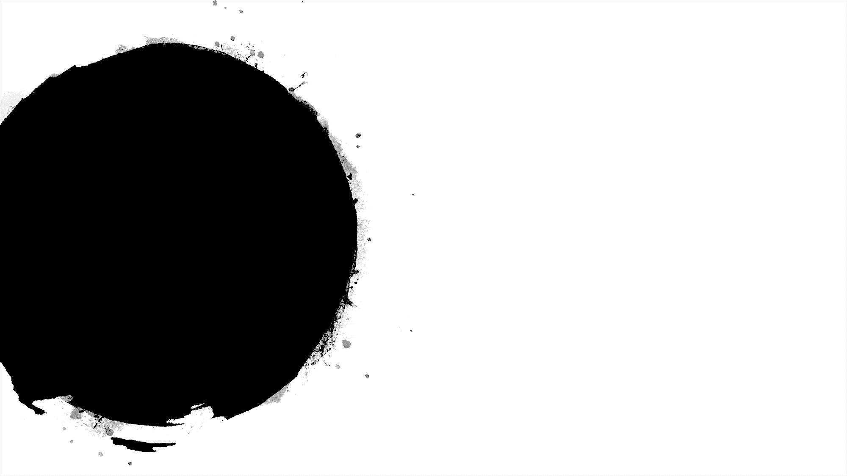
Deep Autoencoders
Multiple Layers
Include convolution/deconvolution for image recognition
Include LSTM, GRU for sequence reconstruction
E.g. text mapping, search

Slide 11
Example of Use: Semantic Hashing
Map documents into binary codes
Binary code represent addresses
Retrieve similar documents by looking in nearby addresses
No search required
Hinton & al. 2008

Slide 12
Variational Autoencoders
Encode input into z_mean, z_log_var in latent space
Latent space contains points z with normal distribution
Sample
z=z_mean+exp(z_log_var)*epsilon
epsilon is in N(0,1)
Decode z into approx. of input
Loss = reconstruction loss + regularization
L= cross – entropy + KL divergence
KL measures distance between latent and prior assumed distribution

Slide 13
Example of Use: Morphing
MNIST numbers decoded from latent space
Note continuous distribution

Slide 14
Demo

